Slide 1
Chapter 1 The Worlds of Database Systems

Slide 2
Objectives
Understand concepts of:
Information, Data, Database
Database Management System (DBMS)
Database System

Slide 3
Contents
1.1 The Evolution of Database Systems
1.2 Overview of Database Management System

Slide 4

1.1 The Evolution of Database Systems
Data
Information
What are the differences between data and information?
Notes:
Data
Raw fact of things
No contextual meaning
Number, text,…
Information:
- Data with exact meaning
- Processed data and organized context

Slide 5
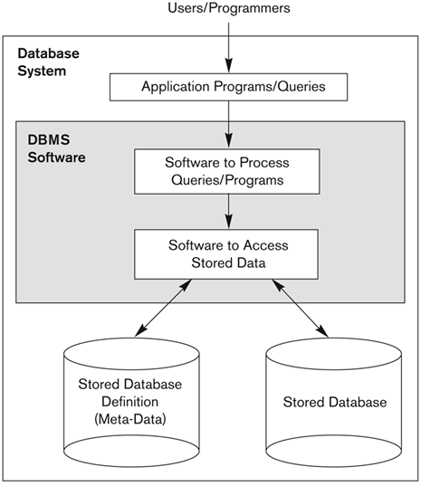
1.1 The Evolution of Database Systems
Database
A collection of information that exists over a long period of time.
A collection of related data.
managed by a DBMS
Database Management System (DBMS)
A software package/system to facilitate the creation and maintenance of a computerized database
Database System
The DBMS software together with the data itself. Sometimes, the applications are also included.

Slide 6
1.1 The Evolution of Database Systems
Early DBMS
1960s, the first DBMS based on file system
The DBMS is expected to
Allow users to create new databases and specify their schemas
Give users the ability to query the data
Support the storage of very large amounts of data
Enable durability
Control access to data from many users at once
Responsibility | Yes/No
(1) | Limited
(2) | Not directly supported
(3) | Yes
(4) | Not always supported
(5) | No

Slide 7
1.1 The Evolution of Database Systems
Hierarchical data model (tree-based model)
Was used in early mainframe DBMS
The IBM Information Management System (IMS) is example of a hierarchical database system
Student
S1
S2
Course
C1
C2
C2
C3
C4
Instructor
I1
I2
I2
I3
I1

Slide 8
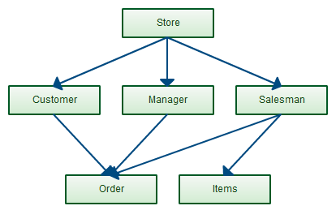
1.1 The Evolution of Database Systems
Network data model (graph-based model)
Charles Bachman invented in the late 1960s
standard specification published in 1969 by the Conference on Data Systems Languages (CODASYL) Consortium
The network model allows each record to have multiple parent and child records
→ Not support high-level query language

Slide 9
1.1 The Evolution of Database Systems
Relational Database Systems
1970s, Edgar Frank "Ted" Codd defined relational model based on relations (*)
Revolutionary idea of DBMS activity
at IBM (System R, DB2)
at Universities like Berkeley (Ingres)
SQL, the most important query language, was developed by IBM in 1974
1979, Oracle v.2, the first commercial RDBMS product using SQL

Slide 10
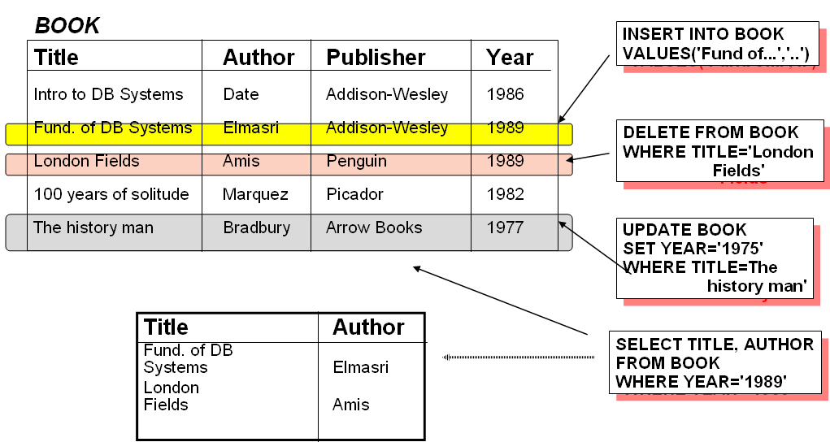
1.1 The Evolution of Database Systems
Book relation example

Slide 11
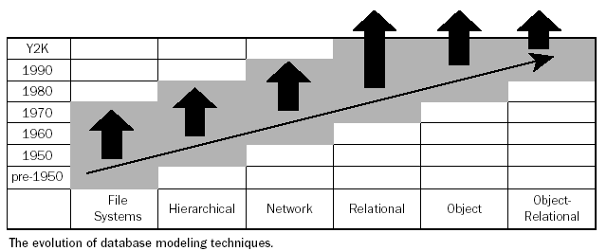
1.1 The Evolution of Database Systems
→ 2000s-now: NoSQL , newSQL

Slide 12
1.1 The Evolution of Database systems
Smaller and Smaller Systems
Originally, DBMS’s were large, expensive software running on large computers
Today, DBMS can run on PC, Mobile, …
⇒DB systems based on the relational model are available for even very small machines
Bigger and Bigger Systems
Size of data has been increasingly continuously
Many databases store petabytes and serve it all to users

Slide 13
1.1 The Evolution of Database systems
Information Integration
Join the information contained in many related databases into a whole
Example: a large company has many divisions, each division have built its own database of products and employees on different DBMS’s and different structures
How we join these databases without any matters
Need to build structures on top of existing databases, with the goal of integrating the information distributed among them

Slide 14
1.1 The Evolution of Database systems
Information Integration (con’t.)
Two popular approaches
Creation of data warehouses, where information from many databases is copied periodically, with the appropriate translation, to a central database
Implementation of a middleware (mediator) that support an integrated model of the data of the various databases, while translating between this model and the actual models used by each database

Slide 15
1.2 Overview of DBMS
Database Management System
DBMS components
Database Users
Database language
Relational databases

Slide 16
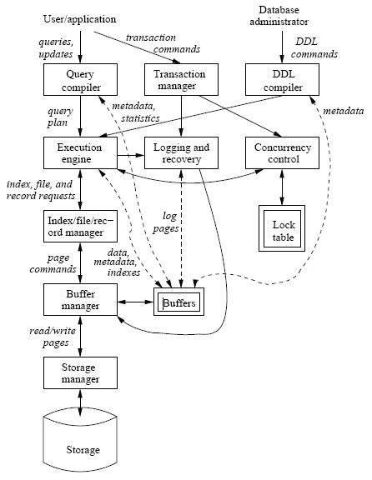
1.2 Overview of DBMS
DBMS components
Single box: system component
Double box: memory data structure
Solid line: control & data flow
Dashed line: data flow only

Slide 17
1.2 Overview of DBMS
Database Users
Database Administrators, authorize access to database, coordinate, monitor its use, acquiring software, and hardware resources, …
Database Designers, define the content, the structure, the constraints, and functions or transactions against the database
Database End users, use data for queries, reports and some of them actually update the database content

Slide 18
1.2 Overview of DBMS
DDL - Data Definition Language Commands
DBA needs special authority to execute schema-altering commands
Schema-altering commands are known as DDL commands, and used for defining data structure
These commands are parsed by a DDL compiler and passed to the execution engine, then goes through the index/file/record manager to alter the metadata (schema information for the database)
Examples: CREATE, ALTER, DROP

Slide 19
1.2 Overview of DBMS
DML - Data Manipulation Language Commands
Are used by computer programs or DB users to retrieve, insert, delete, and update data
Not affect the schema of the database, but affect the content of the database or extract data from database
DML has two separate subsystems
Answering the query
Transaction processing

Slide 20
1.2 Overview of DBMS
1. Answering the query
Query is parsed and optimized by the query compiler which the result is query plan
Query plan is passed to execution engine to execute
2. Transaction processing (will be discussed in the next chapters)
Transaction is a group of some database operations.
Transaction is processed by transaction manager.

Slide 21
The trends of DB design and DBMS
Non relational databases (NoSQL)
MongoDB
Redis
Multi-model databases
Oracle database
Arango DB

Slide 22
Chapter 2 The Relational Model of Data

Slide 23
Objectives
Understand what is the relational model and database design basing relational model.
Conceptualize data using the relational model.
Understand what basic relational algebra operators under set semantics.
Express queries using relational algebra.

Slide 24
Contents
2.1 An Overview of Data Models
2.2 Basics of the Relational Model
2.3 An Algebraic Query Language

Slide 25
2.1 An Overview of Data Models
Data model: a collection of concepts for describing data, including 3 parts:
Structure of the data
Ex: arrays or objects
Operations on the data
Queries and modification on data
Constraints on the data
Limitations on the data

Slide 26
2.1 An Overview of Data Models
The relational model, including object-relational extensions
The semi-structured data model, including XML and related standards
Semi-structured data resembles trees or graphs rather than tables or arrays
XML, a way to represent data by hierarchically nested tagged elements
Operations involve following paths in tree from an element to one or more of its nested sub elements, and so on
Constraints involve the data type of values associated with a nested tag

Slide 27
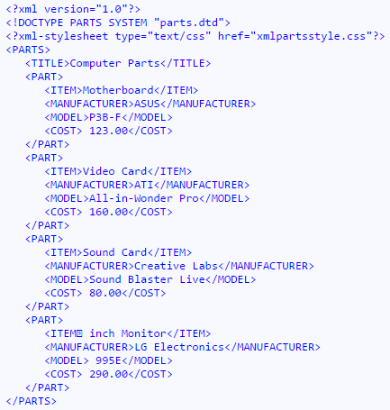
2.1 An Overview of Data Models

Slide 28
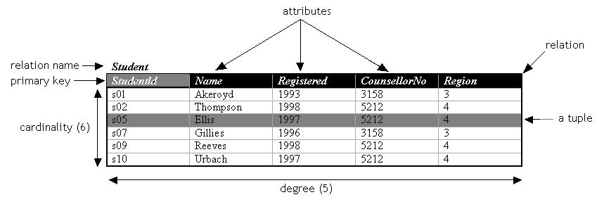
2.2 Basics of the Relational Model
Relational model
A relation is made up from 2 parts:
Schema: specifies name of relation, name of attributes and domain/type of one’s.
Ex: Student(StudentID: string, Name: string, Registered: int, CounsellorNo: int, Region: int)
Instance: a table with rows and columns
Rows ~ cardinality; columns ~ degree/arity
A simple thinking: a relation as a set of distinct rows or tuples

Slide 29
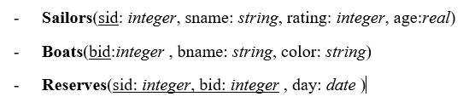
2.2 Basics of the Relational Model
Database schema: a set of schemas for the relations of a database
An example of DB schema:

Slide 30
2.2 Basics of the Relational Model
Key attribute
Non-key attribute
Multi-valued attribute
Derived- attribute
Candidate key
Primary key
Foreign key

Slide 31
2.3 An Algebraic Query Language
Relational Algebra
An ư consists of operators and atomic operands
Relational algebra is an example of an algebra, its atomic operands are
Variables that stand for relations
Constants, which are finite relations
Relational algebra is a set of operations on relations
Operations operate on one or more relations to create new relation

Slide 32
2.3 An Algebraic Query Language
Relational algebra fall into four classes
Set operations – union, intersection, difference
Selection and projection
Cartesian product and joins
Rename

Slide 33
2.3 An Algebraic Query Language
Set operations
Union
R ∪ S = { t | t ∈ R ∨ t ∈ S}
Intersection
R ∩ S = { t | t ∈ R ∧ t ∈ S}
Difference
R \ S = { t | t ∈ R ∧ t ∉ S}
Intersection can be expressed in terms of set difference
R ∩ S = R \ (R \ S)
R and S must be ‘type compatible’
The same number of attributes
The domain of corresponding attributes must be compatible

Slide 34
Set operations- Example
name | address | gender | birthdate
Carrie Fisher | 123 Maple St., Holywood | F | 9/9/99
Mark Hamill | 456 Oak Rd., Brentwood | M | 8/8/88
Relation R
name | address | gender | birthdate
Carrie Fisher | 123 Maple St., Holywood | F | 9/9/99
Harrison Ford | 789 Palm Dr., Beverly Hills | M | 8/8/88
Relation S

Slide 35
Set operations- Example
R ∪ S
name | address | gender | birthdate
Carrie Fisher | 123 Maple St., Holywood | F | 9/9/99
Mark Hamill | 456 Oak Rd., Brentwood | M | 8/8/88
Harrison Ford | 789 Palm Dr., Beverly Hills | M | 8/8/88
R ∩ S
name | address | gender | birthdate
Carrie Fisher | 123 Maple St., Holywood | F | 9/9/99
R \ S
name | address | gender | birthdate
Mark Hamill | 456 Oak Rd., Brentwood | M | 8/8/88

Slide 36
Selection and projection
Selection
- R1 := σ_{C} (R2) with C illustrated conditions
- ex: σ _{<C1>}(σ _{< C2>} ( R)) = σ _{<C2>} (σ _{< C1>} ( R)) = σ _{<C1> AND < C2>}
Movies
title | year | length | genre
Gone With the Wind | 1939 | 231 | Drama
Star Wars | 1977 | 124 | Scifi
Wayne’s World | 1992 | 95 | Comedy
σ_{length≥100}(Movies)
title | year | length | genre
Gone With the Wind | 1939 | 231 | Drama
Star Wars | 1977 | 124 | Scifi
Notes:
The Selection is commutative
The cascaded Selection may be applied in any order
Selection may be replaced by a single selection with a conjunction of all the conditions

Slide 37
Selection and projection
Projection S := π_{A1,A2,…,An} (R)
A1,A2,…,An are attributes of R
S relation schema S(A1,A2,…,An)
Movies
title | year | length | genre
Star Wars | 1977 | 124 | Scifi
Galaxy Quest | 1999 | 104 | Comedy
Wayne’s World | 1992 | 95 | Comedy
π_{title,year,length}(Movies)
π_{genre}(Movies)
title | year | length
Star Wars | 1977 | 124
Galaxy Quest | 1999 | 104
Wayne’s World | 1992 | 95
genre
Scifi
Comedy

Slide 38
Cartesian product and joins
Cartesian product R3 := R1 Χ R2
Relation R
Relation S
Cartesian Product R X S
A | B
1 | 2
3 | 4
B | C | D
2 | 5 | 6
4 | 7 | 8
9 | 10 | 11
A | R.B | S.B | C | D
1 | 2 | 2 | 5 | 6
1 | 2 | 4 | 7 | 8
1 | 2 | 9 | 10 | 11
3 | 4 | 2 | 5 | 6
3 | 4 | 4 | 7 | 8
3 | 4 | 9 | 10 | 11
Notes:
R3 := R1 Χ R2
Pair each tuple t1 of R1 with each tuple t2 of R2
Concatenation t1t2 is a tuple of R3
Schema of R3 is the attributes of R1 and then R2, in order
But beware attribute A of the same name in R1 and R2: use R1.A and R2.A
Suppose R1 has n1 attributes and tt1 tuples, R2 has n2 attributes and tt2 tuples, then R3 has (n1+n2) attributes, and (tt1*tt2) tuples

Slide 39
Cartesian product and joins
theta joins R3 := R1 ⋈_{<join condition>} R2
A | B | C
1 | 2 | 3
6 | 7 | 8
9 | 7 | 8
B | C | D
2 | 3 | 4
2 | 3 | 5
7 | 8 | 10
A | U.B | U.C | V.B | V.C | D
1 | 2 | 3 | 2 | 3 | 4
1 | 2 | 3 | 2 | 3 | 5
1 | 2 | 3 | 7 | 8 | 10
6 | 7 | 8 | 7 | 8 | 10
9 | 7 | 8 | 7 | 8 | 10
Relation U
Relation V
Figure 2.17: Result of U ⋈ _{A<D} V
A | U.B | U.C | V.B | V.C | D
1 | 2 | 3 | 7 | 8 | 10
Result of U ⋈ _{A<D AND U.B≠V.B} V
Notes:
R3 := R1 ⋈_{<join condition>} R2
Each tuple t1 of R1 connects with all those tuple t2 of R2 that satisfy <join condition>
<join condition> refers to attributes of R1 and R2
Schema of R3 is the attributes of R1 and then R2, in order
But beware attribute A of the same name in R1 and R2: use R1.A and R2.A
The result is constructed as follows
Take the product of R1 and R2
Select from the product only those tuples that satisfy the <join condition>
R1 ⋈_{<join condition>} R2 = σ _{<join condition>} (R1 x R2)

Slide 40
Cartesian product and joins
Natural join R3 := R1 ⋈ R2
Relation R
Relation S
Natural Join R ⋈ S
A | B
1 | 2
3 | 4
B | C | D
2 | 5 | 6
4 | 7 | 8
9 | 10 | 11
A | B | C | D
1 | 2 | 5 | 6
3 | 4 | 7 | 8
Notes:
R3 := R1 ⋈ R2
Pair only those tuples from R1 and R2 that agree in whatever attributes are common to the schema of R1 and R2
The result R3 keeps one component for each of the attributes in the union of the schemas of R1 and R2

Slide 41
Rename
The ρ operation gives a new schema to a relation
ρ_{S(A1,…,An)}(R) makes S be a relation with attributes A1,…,An and the same tuples as R
Simplified notation: S:=R (A1,A2,…,An)
R X ρ_{S(X,C,D)} (S)
Relation R
Relation S
A | B
1 | 2
3 | 4
B | C | D
2 | 5 | 6
4 | 7 | 8
9 | 10 | 11
A | B | X | C | D
1 | 2 | 2 | 5 | 6
1 | 2 | 4 | 7 | 8
1 | 2 | 9 | 10 | 11
3 | 4 | 2 | 5 | 6
3 | 4 | 4 | 7 | 8
3 | 4 | 9 | 10 | 11

Slide 42
Relational Expression
How we need relational expression
Relational algebra allows us to form expressions
Relational expression is constructed by applying operations to the result of other operations
Expressions can be presented as expression tree

Slide 43
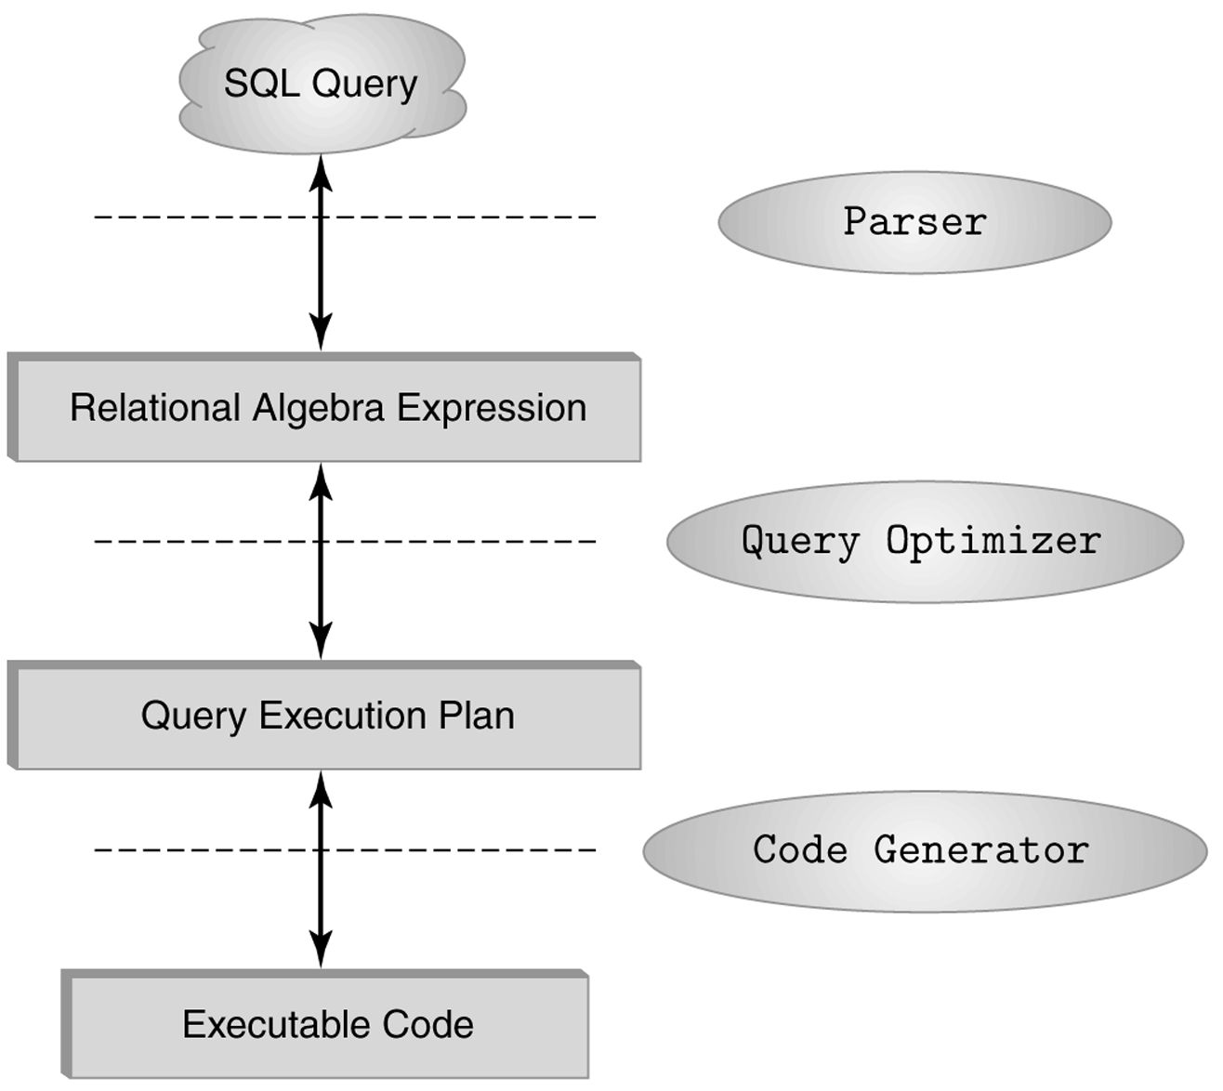
The role of relational algebra in a DBMS

Slide 44
Relational Expression
Example: What are the titles and years of movies made by Fox that are at least 100 minutes long?
(1) Select those Movies tuples that have length ≥ 100
(2) Select those Movies tuples that have studioName=‘Fox’
(3) Compute the intersection of (1) and (2)
(4) Project the relation from (3) onto attributes title and year

Slide 45
Relational Expression
π_{title,year}
∩
σ_{length>=100}
σ_{studioName=‘Fox’}
Movies
Movies
Figure 2.18: Expression tree for a relational algebra expression
π_{title,year}(σ_{length≥100} (Movies) ∩ σ_{studioName=‘Fox’} (Movies))
π_{title,year}(σlength≥100 AND studioName=‘Fox’ (Movies))

Slide 46
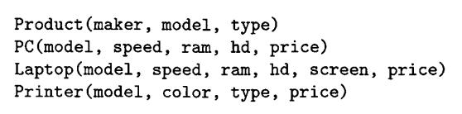
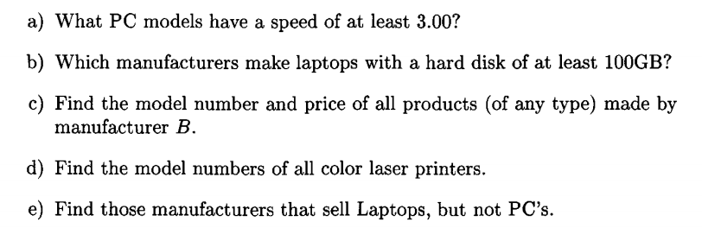
Exercise

Slide 47
Chapter 3 Design Theory for Relational Databases

Slide 48
Objectives
Understand concepts of:
Functional Dependencies
Normalization
Decomposition
Multi-valued Dependencies

Slide 49
Contents
Functional Dependencies
Rules about FDs
Key & Super-Key
Normal forms

Slide 50
Functional dependency
A functional dependency: constraint between two sets of attributes in a relation
A set of attributes X (include A₁A₂…A_{n}) in R functionally determine another attribute Y (include B₁B₂…B_{m}), also in R, (written X → Y) if and only if each X value is associated with precisely one Y value
A functional dependency A₁A₂…A_{n} → B₁B₂…B_{m} holds on relation R if two tuples of R agree on all of the attributes A₁, A₂, …, A_{n} then they must also agree on all of the attributes B₁, B₂, …, B_{m}

Slide 51
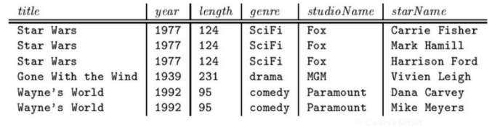
Functional dependency
Easy to see that: the following FD is true
title,year → length, genre, studioName
Exercise: How about the FD
title,year → starName
title, year → startName does not hold in Movies1 relation
Notes:
Give Movie relation, answer below questions:
1. What are the keys of relation?
2. What if we ignore the column starName?
3. Can starName be a key?
Easy to see that: the following FD is true
title,year → length, genre, studioName
Exercise: How about the FD
title,year → starName
title, year → startName does not hold in Movies1 relation

Slide 52
Functional dependency
Review key of relation, candidate keys(alternate keys), primary key
Super-key
A set of attributes that contains a key is called a super-key
Every super-key satisfies the first condition of a key: it functionally determines all other attributes of the relation
If K is a key, L is a super key, then: K ⊆ L
A key is also a super key

Slide 53
Functional dependency
Armstrong’s Axioms
Fundamental Rules: Let X, Y, Z are sets of attributes
Reflexivity:
If X is a subset of Y, then Y→X
Augmentation
If X→Y, then XZ→YZ for any Z
Transitivity
If X→Y and Y→Z, then X→Z
Additional rules: Let X, Y, Z, W are sets of attributes
Union/Combining: if X→Y AND X→Z then X→YZ
Decomposition/Splitting: if X→YZ, then X→Y and X→Z
Pseudotransitivity: If X → Y and WY → Z then WX →Z
Trivial FDs: right side is a subset of left side
Ex: FLD →FD

Slide 54
Functional dependency
A set of FD’s S follows from a set of FD’s T if every relation instance that satisfies all the FD’s in T also satisfies all the FD’s in S
Two sets of FD’s S and T are equivalent if and only if S follows from T, and T follows S

Slide 55
The Closure of Attributes
The closure of a set of attributes {A₁, A₂, …, A_{n}} under FD’s in S (denoted {A₁, A₂, …, A_{n}}⁺) is the set of attributes B such that every relation that satisfies all the FD’s in set S also satisfies A₁A₂…A_{n}→ B
That is, A₁A₂…A_{n}→ B follows from the FD’s of S
A₁, A₂, …, A_{n} ∈ {A₁, A₂, …, A_{n}}+, because A₁A₂…A_{n}→A_{i} is trivial

Slide 56
The Closure of Attributes
Algorithm 3.7: Closure of a set of attributes
Input: A set of attributes {A₁,A₂,…,A_{n}} and a set of FD’s S
Output: The closure {A₁,A₂,…,A_{n}}⁺
If necessary, split the FD’s of S, so each FD in S have singleton right side
Let X be a set of attributes that will become the closure. Initialize X to be {A₁,A₂,…,A_{n}}
Repeatedly search for some FD: B₁B₂…B_{m} → C, such that B₁, B₂, …, B_{m} are in X, but C is not
If such C is found, add to X, and repeat the search
If such C is not found, no more attributes can be added to X
The set X is the correct value of {A₁, A₂, …, A_{n}}+

Slide 57
The Closure of Attributes
R(A, B, C, D)
S={A→B, B→C, C→D, D→A}
Compute {A}⁺ ? {B}⁺ ?
What are some the keys of R?

Slide 58
Closing Sets of Functional Dependencies
Suppose a set of FD’s S, any set of FD’s T equivalent to S is said to be a basis for S. Then we say T is a basis for S
Just work with only FD’s that have singleton right sides
A minimal basis for FD’s S is a basis B that satisfies three conditions:
All the FD’s in B have singleton right sides
If any FD is removed from B, the result is no longer a basis
If for any FD in B we remove one or more attributes from the left side, the result is no longer a basis

Slide 59
Closing Sets of Functional Dependencies
Example
R(A,B,C)
S={A→ B, A → C, B → A, B → C, C → A, C → B, AB → C, BC → A, AC → B, A → BC, B → AC, C → AB}
R and its FD’s have several minimal basis
{A → B, B → A, B → C, C → B}, or
{A → B, B → C, C → A}

Slide 60
What happens to …
… a set of FD’s S of R when we project R on some attributes?
That is, suppose a relation R with set of FD’s S, and R₁=π_{L}(R). What FD’s hold in R₁?

Slide 61
Projecting Functional Dependencies
To find a functional dependencies of projection, we
Follow from S, and
Involve only attributes of R₁

Slide 62
Projecting Functional Dependencies
Algorithm 3.12: Projecting a Set of FD’s
Input: R, R₁=π_{L}(R), S a set of FD’s that hold in R
Output: the set of FD’s that hold in R₁
Method:
T is the set of FD’s that hold in R₁. Initially, T is empty
For each set of attributes X of R₁, compute X+. Add to T all non-trivial FD’s X → A such that A is both in X+ and an attribute of R₁
Construct a minimal basis from T

Slide 63
Projecting Functional Dependencies
Algorithm 3.12: Projecting a Set of FD’s (cont)
Compute a minimal basis from T
If there is an FD F in T that follows from other FD’s in T, then remove F from T
Let Y → B is a FD in T , with at least two attributes in Y, and let Z is Y with one of its attributes removed:
If Z → B follows from the other FD’s in T (including Y → B), then replace Y → B by Z → B
Repeat the above steps in all possible ways until no more changes to T can be made

Slide 64
Projecting Functional Dependencies
Two notations
(1) Closing the empty set and the set of all attributes cannot yield a nontrivial FD
(2) If we have already knew that the closure of some set X is all attributes, then we cannot discover any new FD’s by closing supersets of X

Slide 65
Projecting Functional Dependencies
Example: Suppose R(A,B,C,D) has FD’s A→B, B→C, and C→D. R1=π_{A,C,D}(R). Find the FD’s of R1?
Compute the closure of the singleton set
{A}+={A,B,C,D}, and B is not in R1, then new FD’s A→C, A→D
{C}+={C,D}, then new FD’s C→D
{D}+={D}, no new FD’s
Compute the closure of the doubleton set
Since {A}+ include all attributes, no care any more for supersets of {A}
{C,D}+={C,D}, no new FD’s holds in R1
Finally, there are three FD’s A→C, A→D, C→D hold in R1
A→D is transitive from A→C, and C→D
So, minimal basis is {A→C, C→D}

Slide 66
Anomalies introduction
Careless selection of a relational database schema can lead to redundancy and related anomalies
So, in this session we shall tackle the problems of relational database designing
Problems such as redundancy that occur when we try to cram too much into a single relation are called anomalies

Slide 67
Anomalies
The principal kinds of anomalies that we encounter are:
Redundancy: information maybe repeated unnecessarily in several tuples (exp: the length and genre)
Update Anomalies: We may change information in one tuple but leave the same information unchanged in another (exp: if we found that Star Wars is 125 minutes long, we may change the length in the first tuple but not in the second and third tuples)
Deletion Anomalies: If a set of values becomes empty, we may lose other information as a side effect (exp: if we delete “Fox” from the set of studios, then we have no more studios for the movie “Star Wars”

Slide 68
Decomposition
The accepted way to eliminate anomalies is the decomposition of relations
Decomposition of a relation R involves splitting the attributes of R to make the schemas of 2 new relations
Definition: Given a relation R(A₁,..,A_{n}), we say R is decomposed into S(B₁,..,B_{m}) and T(C₁,..,C_{k}) if: + {A₁,..,A_{n}} = {B₁,..,B_{m}} U {C₁,..,C_{k}} + S = ∏_{B1,..Bm}(R) + T = ∏_{C1,..,Ck}(R)

Slide 69
Example: Decomposition

Slide 70
Discuss
The redundancy is eliminated (the length of each film appears only once)
The risk of an update anomaly is gone (we only have to change the length of Star Wars in one tuple)
The risk of a deletion anomaly is gone (if we delete all the stars for Gone with the wind, that deletion makes the movie disappear from the right but still be found in the left)

Slide 71
Decomposition: The Good, Bad and Ugly
We observed that before we decompose a relation schema into BCNF, it can exhibit anomalies; That’s the “Good”
However, decomposition can also have some bad:
Maybe we can’t recovery the original information; OR
After reconstruction, the FDs maybe not hold

Slide 72
Example: Loss of information after decomposition
Suppose we have R(A,B,C) but neither of the FD’s B->A nor B->C holds.
R is decomposed into R1 and R2 as above
When we try to re-construct R by Natural Join of R1 and R2, we have: R3 = R1 X R2 (but R3 <> R1 => We lost information)

Slide 73
Example: Dependency Loss
If we check the projected FD’s in the relations of the decomposition, can we can be sure that when we reconstruct the original relation from the decomposition by joining, the result will satisfy the original FD’s?

Slide 74
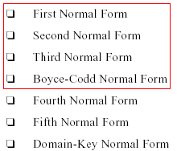
Normal Forms

Slide 75
Dependencies: Definitions
Multivalued Attributes (or repeating groups): non-key attributes or groups of non-key attributes the values of which are not uniquely identified by (directly or indirectly) (not functionally dependent on) the value of the Primary Key (or its part).
Partial Dependency – when a non-key attribute is determined by a part, but not the whole, of a COMPOSITE primary key.
Transitive Dependency – when a non-key attribute determines another non-key attribute.

Slide 76

1NF
1NF A relation R is in first normal form (1NF) if and only if all underlying domains contain atomic values only
Take the following table.
StudentID is the primary key.
Is it 1NF?
Notes:
atomic values:
=one value for an attribute
= no repeating groups
= no multivalued attributes
= no composite attributes

Slide 77
No. There are repeating groups (subject, subjectcost, grade)
How can you make it 1NF?

Slide 78

Create new rows so each cell contains only one value
But now look – is the studentID primary key still valid?

Slide 79
No – the studentID no longer uniquely identifies each row
You now need to declare studentID and subject together to uniquely identify each row.
So the new key is StudentID and Subject.

Slide 80
So. We now have 1NF.
Is it 2NF?

Slide 81
2NF
A relation R is in second normal form (2NF) if and only if it is in 1NF and every non-key attribute is fully dependent on the primary key
StudentName & Address are dependent on studentID (which is part of the key)
But they are not dependent on Subject (the other part of the key)

Slide 82
And 2NF requires…
All non-key fields are dependent on the ENTIRE key (studentID + subject)

Slide 83
So it’s not 2NF
How can we fix it?

Slide 84
Make new tables
Make a new table for each primary key field
Give each new table its own primary key
Move columns from the original table to the new table that matches their primary key…

Slide 85
Step 1
STUDENT TABLE (key = StudentID)

Slide 86

Step 2
STUDENT TABLE (key = StudentID)
SUBJECTS TABLE (key = Subject)

Slide 87



Step 3
STUDENT TABLE (key = StudentID)
SUBJECTS TABLE (key = Subject)
RESULTS TABLE (key = StudentID+Subject)

Slide 88
Step 3
STUDENT TABLE (key = StudentID)
SUBJECTS TABLE (key = Subject)
RESULTS TABLE (key = StudentID+Subject)

Slide 89
Step 4 - relationships
STUDENT TABLE (key = StudentID)
SUBJECTS TABLE (key = Subject)
RESULTS TABLE (key = StudentID+Subject)

Slide 90
Step 4 - cardinality
STUDENT TABLE (key = StudentID)
1
Each student can only appear ONCE in the student table
SUBJECTS TABLE (key = Subject)
RESULTS TABLE (key = StudentID+Subject)

Slide 91
Step 4 - cardinality
STUDENT TABLE (key = StudentID)
1
SUBJECTS TABLE (key = Subject)
1
Each subject can only appear ONCE in the subjects table
RESULTS TABLE (key = StudentID+Subject)

Slide 92
Step 4 - cardinality
STUDENT TABLE (key = StudentID)
1
SUBJECTS TABLE (key = Subject)
1
A subject can be listed MANY times in the results table (for different students)
8
RESULTS TABLE (key = StudentID+Subject)

Slide 93
Step 4 - cardinality
STUDENT TABLE (key = StudentID)
1
SUBJECTS TABLE (key = Subject)
1
A student can be listed MANY times in the results table (for different subjects)
8
8
RESULTS TABLE (key = StudentID+Subject)

Slide 94
A 2NF check
STUDENT TABLE (key = StudentID)
1
SUBJECTS TABLE (key = Subject)
1
SubjectCost is only dependent on the primary key,
Subject
8
8
RESULTS TABLE (key = StudentID+Subject)

Slide 95
A 2NF check
STUDENT TABLE (key = StudentID)
1
SUBJECTS TABLE (key = Subject)
1
8
8
Grade is only dependent on the primary key (studentID + subject)
RESULTS TABLE (key = StudentID+Subject)

Slide 96
A 2NF check
STUDENT TABLE (key = StudentID)
1
Name, Address are only dependent on the primary key
(StudentID)
SUBJECTS TABLE (key = Subject)
1
8
8
RESULTS TABLE (key = StudentID+Subject)

Slide 97
But is it 3NF?
STUDENT TABLE (key = StudentID)
1
So it is 2NF!
SUBJECTS TABLE (key = Subject)
1
8
8
RESULTS TABLE (key = StudentID+Subject)

Slide 98
3NF
A relation R is in third normal form (3NF) if and only if it is in 2NF and every non-key attribute is non-transitively dependent on the primary key.
An attribute C is transitively dependent on attribute A if there exists an attribute B such that: A->B and B->C
Note that 3NF is concerned with transitive dependencies which do not involve candidate keys. A relation with more than one candidate key will clearly have transitive dependencies of the form: primary_key -> other_candidate_key -> any_non-key_column
Notes:
Third Normal Form is violated if:
Second Normal Form is violated
If there exists a non-key field(s) which is functionally dependent on another non-key field(s).
non-key → non-key

Slide 99
A 3NF check
STUDENT TABLE (key = StudentID)
1
Oh oh…
What?
SUBJECTS TABLE (key = Subject)
1
8
8
RESULTS TABLE (key = StudentID+Subject)

Slide 100
A 3NF check
STUDENT TABLE (key = StudentID)
1
HouseName is dependent on both StudentID + HouseColour
SUBJECTS TABLE (key = Subject)
1
8
8
RESULTS TABLE (key = StudentID+Subject)

Slide 101
A 3NF check
STUDENT TABLE (key = StudentID)
1
Or HouseColour is dependent on both StudentID + HouseName
SUBJECTS TABLE (key = Subject)
1
8
8
RESULTS TABLE (key = StudentID+Subject)

Slide 102
A 3NF check
STUDENT TABLE (key = StudentID)
1
But either way,
non-key fields are dependent on MORE THAN THE PRIMARY KEY (studentID)
SUBJECTS TABLE (key = Subject)
1
8
8
RESULTS TABLE (key = StudentID+Subject)
Notes:
X→A, co A la thuoc tinh khoa hoac X la sieu khoa

Slide 103
A 3NF check
STUDENT TABLE (key = StudentID)
1
And 3NF says that non-key fields must depend on nothing but the key
SUBJECTS TABLE (key = Subject)
1
8
8
RESULTS TABLE (key = StudentID+Subject)
Notes:
nothing but: không co cai gi ngoai

Slide 104
A 3NF check
STUDENT TABLE (key = StudentID)
1
WHAT DO WE DO?
SUBJECTS TABLE (key = Subject)
1
8
8
RESULTS TABLE (key = StudentID+Subject)

Slide 105

Again, carve off the offending fields
1
SUBJECTS TABLE (key = Subject)
8
8
1
RESULTS TABLE (key = StudentID+Subject)

Slide 106

A 3NF fix
1
SUBJECTS TABLE (key = Subject)
8
8
1
RESULTS TABLE (key = StudentID+Subject)

Slide 107
A 3NF fix
8
1
1
SUBJECTS TABLE (key = Subject)
8
8
1
RESULTS TABLE (key = StudentID+Subject)

Slide 108
A 3NF win!
8
1
1
8
8
1
SUBJECTS TABLE (key = Subject)
RESULTS TABLE (key = StudentID+Subject)
Or…

Slide 109
The Reveal
Before…
After…
1
8
1
1
8
8
SUBJECTS TABLE (key = Subject)
RESULTS TABLE (key = StudentID+Subject)

Slide 110
3NF No transitive dependencies
Table contains data from an embedded entity with non-key attributes.
TABLE
SUB-TABLE
TABLE
??
SUB-TABLE
BCNF is the same, but the embedded table may involve key attributes.

Slide 111
BCNF
A relation R is in BCNF if and only if: Whenever there is a Non-Trivial FD A₁A₂..A_{n} -> B₁B₂..B_{m} for R, it is the case that: {A₁,..,A_{n}} is a super-key for R
That is: the left side of every Non-Trivial FD must be a super-key
Notes:
Non-trivial FD: phu thuoc tam thuong
Boyce-Codd Normal Form is violated if:
Third Normal Form is violated
If there exists a partial key which is functionally dependent on a non-key field(s).
non-key → partial-key

Slide 112
Example: BCNF or not
The above relation is not in BCNF because: Consider the FD: {title,year} -> {length, genre, studioName} We know that {title, year} is not a super-key

Slide 113
Example: BCNF or not
The above relation is in BCNF because: {title,year} -> {length, genre, studioName}
And: neither title nor year by itself functionally determines any of the other attributes

Slide 114
Example: BCNF or not
The above relation is in BCNF because: it has no Non-Trivial FD

Slide 115
Differences between BCNF and 3NF
3NF | Boyce-Codd
a nontrivial functional dependency: X => A holds in R, either X is a superkey of R, or (b) A is a prime attribute of R. | a nontrivial functional dependency X => A holds in R, then: X is a superkey of R
Note:A functional dependency X => Y is a full functional dependency if removal of any attribute A from X means that the dependency does not hold any more; A partial functional dependency is not a full functional dependency

Slide 116
BCNF decomposition algorithm (self studying)
Input: A relation R with a set of FD’s F
Output: A BCNF decomposition of R with lossless join Method:
At each step compute the key for the sub-relation R
if not in BCNF, pick any FD X->Y which violates
break the relation into 2 sub-relations
R1(XY)
R2(S - Y)
this has a lossless join
project FD's onto each sub-relation
continue until no more offending FD's

Slide 117
3NF decomposition algorithm – self studying
Input: A relation R with a set of FD’s F
Output: A decomposition of R into a collection of relations, all of which are in 3NF. This decomposition has a lossless join and dependency-preservation.
Method:
Find minimal basic for F, say G.
∀ X-A ∈ G, use XA as the schema of one relations in the decomposition.
If none of the sets of relations from Step 2 is a super key for R, add another relation whose schema is a key for R.

Slide 118
Summary 1
Decompose a relation into BCNF is a solution for eliminating anomalies
But BCNF can cause information loss and dependency loss
3NF is a relax solution of BCNF that keep loss-less join and dependency-preservation properties

Slide 119
Summary 2:
2NF | 3NF | Boyce-Codd
every nonprime attribute A in R is not partially dependent on any key of R | a nontrivial functional dependency: X => A holds in R, either X is a superkey of R, or (b) A is a prime attribute of R. | a nontrivial functional dependency X => A holds in R, then: X is a superkey of R
Note:A functional dependency X => Y is a full functional dependency if removal of any attribute A from X means that the dependency does not hold any more; A partial functional dependency is not a full functional dependency

Slide 120
Chapter 4. High-Level Database Model

Slide 121
Objectives
Understand the Database Design Process
Understand data modeling basing on entity relationship
Design a suitable database adapted business requirements in reality

Slide 122
Contents
Database design process
Entity relationship model
What are entity, entity set, attribute, relationship?
Entity Relationship Diagram (ERD)
Attributes on Relationships
Weak Entities
Sub-class

Slide 123
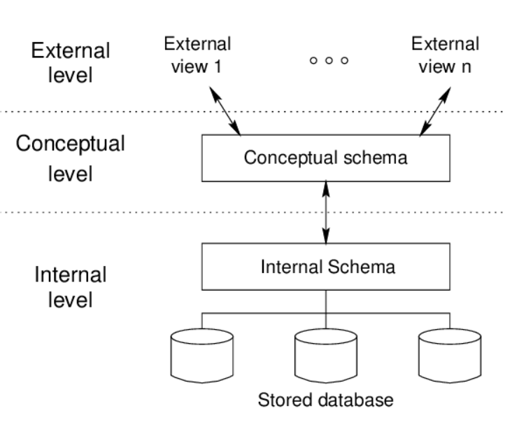
Data model - Overview

Slide 124
Database modeling and implementation process
Getting
User
Requirement
High-Level
Design
Relational
Database
Schema
Design
Relational DBMS
ER diagram
Relational Database Schema
Figure 4.1: The database modeling and implementation process
Notes:
Data Model - a group of conceptual tools that describes data, its relationships and semantics. It also consists of the consistency constraints that the data adheres to.

Slide 125
Steps in Database Design
Requirements Analysis
- user needs; what must database do?
Conceptual Design
- high level description (Entity Relationship diagram)
Logical Design
- translate ERD into DBMS data model
Schema Refinement
- consistency, normalization
Physical Design
- indexes, disk layout
Security Design
- who accesses what, and how

Slide 126
ERD – How to construct
Gather all the data that needs to be modeled.
Identify data that can be modeled as real world entities.
Identify the attributes for each entity.
Sort entity sets as weak or strong entity sets.
Sort entity attributes as key attributes, multi-valued attributes, composite attributes, derived attributes.
Identify the relations between the different entities.
Using the different symbols draw the entities, their attributes and their relationships. Use appropriate symbols while drawing attributes.

Slide 127
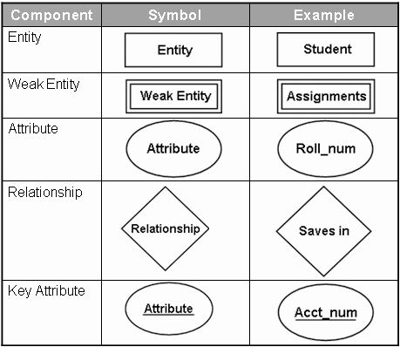
Entity Relationship Diagram - Notations

Slide 128
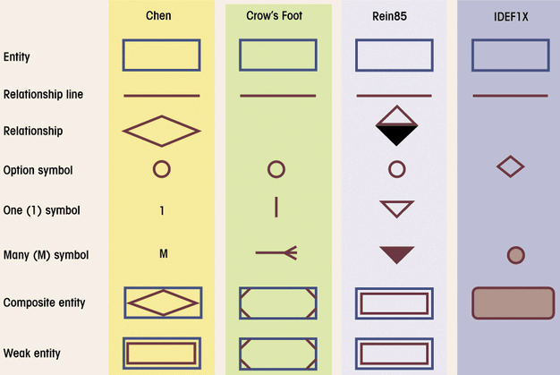
Comparison of E-R Modeling notations

Slide 129
ERD - Entity
Entity:
Real-world thing, distinguishable from other objects.
Noun phrase
Entity described by set of attributes.
Entity Set: A collection of similar entities. E.g., all employees.
All entities in an entity set have the same set of attributes. (Until we consider hierarchies, anyway!)
Each attribute has a domain.
name
ssn
lot
Employee

Slide 130
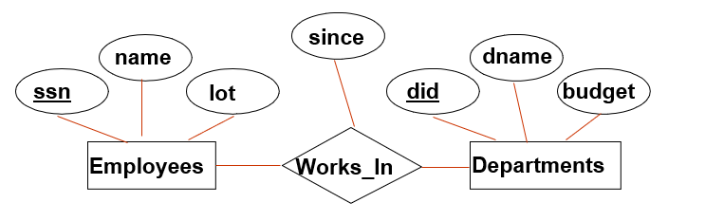
Relationship
Relationship: Association among two or more entities
relationships can have their own attributes (descriptive attributes).
verb phrases
1-1
1-M/M-1
M-M
Degree Constraints
Recursive relationship
Unary, Binary, Ternary relationship
A referential integrity constraints
A value appearing in one context must also appear in another

Slide 131
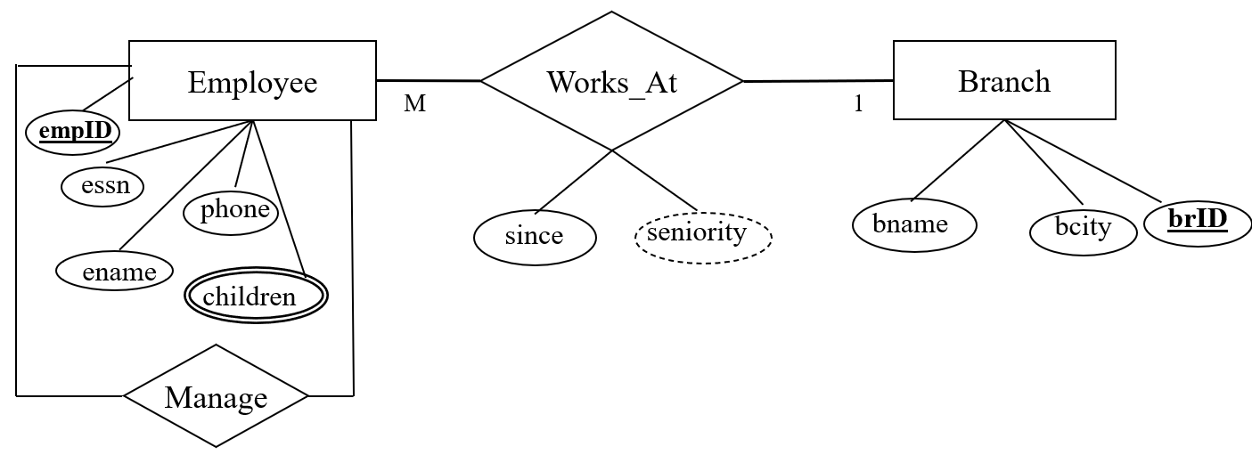
Type of Attributes
EmpID
Key attribute
Multivalued attribute
Derived attribute
Composite attribute
children
seniority
Address
Address

Slide 132
Weak Entity Sets
Consider the relationship
An entity set’s key to be composed of attributes, some or all of which belong to another entity set. Such an entity set is called a weak entity set.
number
crewChief
name
address
Crews
Unit-of
Studios
M
1
Weak entity set
Supporting entity set
1

Slide 133
Requirements for Weak Entity Sets
R is a relationship from E to F
R is called supporting relationship if
R must be a binary, many-one relationship from E to F
R must have referential integrity from E to F
The attributes that F supplies for the key of E must be key attributes of F

Slide 134
Weak Entity Sets
Example weak entity set
Contracts
salary
M
Studio-of
Movie-of
Star-of
1
1
1
Stars
Studios
Movies
genre
year
length
name
addr
title
name
addr

Slide 135
Subclasses in E/R Model
Consider Cartoons and Murder Mysteries are the special kinds of movies, with some special properties
to Stars
length
title
year
genre
Movies
Voices
isa
isa
weapon
Cartoons
Murder Mysteries

Slide 136
Example COMPANY Database – Construct ERD
Requirements of the Company (oversimplified for illustrative purposes)
The company is organized into DEPARTMENTs. Each department has a name, number and an employee who manages the department. We keep track of the start date of the department manager.
Each department controls a number of PROJECTs. Each project has a name, number and is located at a single location.

Slide 137
Example COMPANY Database (Cont.)
We store each EMPLOYEE’s social security number, address, salary, sex, and birthdate. Each employee works for one department but may work on several projects. We keep track of the number of hours per week that an employee currently works on each project. We also keep track of the direct supervisor of each employee.
Each employee may have a number of DEPENDENTs. For each dependent, we keep track of their name, sex, birthdate, and relationship to employee.

Slide 138
From ER Diagram to Relational Model
Overview:
1 entity = 1 relation
attributes of entity ~ attributes of relation
key of entity ~ key of relation
Convert 1-1 relationship
Convert 1-M relationship
Put key attribute of one-side to M-side
Convert M-M relationship
Generate 1 relation, Primary key of this relation combined from two relations. Attributes of new relation ~ attributes of relationship (if have)

Slide 139
From ER Diagram to Relational Model Convert 1-1 relationship
For one-to-one relationship w/out total participation
Build a table with two columns, one column for each participating entity set’s primary key. Add successive columns, one for each descriptive attributes of the relationship set (if any).
For one-to-one relationship with one entity set having total participation
Augment one extra column on the right side of the table of the entity set with total participation, put in there the primary key of the entity set without complete participation as per to the relationship.

Slide 140
Convert N-ary Relationship Set
P-Key1
D-Attribute
A-Key
E-Set 1
P-Key2
A relationship
Another Set
E-Set 2
P-Key3
E-Set 3
P-Key1 | P-Key2 | P-Key3 | A-Key | D-Attribute
9999 | 8888 | 7777 | 6666 | Yes
1234 | 5678 | 9012 | 3456 | No
* Primary key of this table is P-Key1 + P-Key2 + P-Key3

Slide 141
Representing Composite Attribute
Relational Model Indivisibility Rule Applies
One column for each component attribute
NO column for the composite attribute itself
SSN
Name
SSN | Name | Street | City
9999 | Dr. Smith | 50 1st St. | Fake City
8888 | Dr. Lee | 1 B St. | San Jose
Professor
Address
Street
City

Slide 142
Representing Multivalue Attribute
For each multivalue attribute in an entity set/relationship set
Build a new relation schema with two columns
One column for the primary keys of the entity set/relationship set that has the multivalue attribute
Another column for the multivalue attributes. Each cell of this column holds only one value. So each value is represented as an unique tuple
Primary key for this schema is the union of all attributes

Slide 143
Example – Multivalue attribute
SID
Name
The primary key for this table is Student_SID + Children, the union of all attributes
Children
Student
Major
GPA
Stud_SID | Children
1234 | Johnson
1234 | Mary
5678 | Bart
5678 | Lisa
5678 | Maggie
SID | Name | Major | GPA
1234 | John | CS | 2.8
5678 | Homer | EE | 3.6

Slide 144
Representing Class Hierarchy
Two general approaches depending on disjointness and completeness
For non-disjoint and/or non-complete class hierarchy:
create a table for each super class entity set according to normal entity set translation method.
Create a table for each subclass entity set with a column for each of the attributes of that entity set plus one for each attributes of the primary key of the super class entity set
This primary key from super class entity set is also used as the primary key for this new table

Slide 145
Example
SSN
Name
Person
SID
Status
Gender
ISA
Student
Major
GPA
SSN | Name | Gender
1234 | Homer | Male
5678 | Marge | Female
SSN | SID | Status | Major | GPA
1234 | 9999 | Full | CS | 2.8
5678 | 8888 | Part | EE | 3.6

Slide 146
Representing Class Hierarchy
Two general approaches depending on disjointness and completeness
For disjoint AND complete mapping class hierarchy:
DO NOT create a table for the super class entity set
Create a table for each subclass entity set include all attributes of that subclass entity set and attributes of the superclass entity set
Simple and Intuitive enough, need example?

Slide 147
Example
SSN
Name
No table created for superclass entity set
SJSU people
ISA
SID
Student
Faculty
Disjoint and Complete mapping
Major
GPA
Dept
SSN | Name | SID | Major | GPA
1234 | John | 9999 | CS | 2.8
5678 | Mary | 8888 | EE | 3.6
SSN | Name | Dept
1234 | Homer | C.S.
5678 | Marge | Math

Slide 148
Representing Aggregation
Name
SSN
Name
M
Advisor
1
Student
Professor
Dept
SID
Name
member
Primary Key of Advisor
Dept
SID | Code
1234 | 04
5678 | 08
Code
Primary key of Dept

Slide 149
From E/R Relationship to Relations
Stars
Contracts
Movies
Studio
of star
Producing
studio
Studios
Contracts(starName, title,year, studioOfStar_name, producingStudio_name)

Slide 150
Combining Relations
name
address
Movies(title,year,length,genre)
Owns(title,year,studioName)
Stars
title
year
Stars-in
name
Movies
Studios
Owns
length
genre
address
Movies(title,year,length,genre,studioName)
Suppose an entity set E and a many-one relationship R from E to F. We can combine two relations E and R into one relation with a schema consisting of:
All attributes of E,
The key attributes of F, and all own attributes belonging to relationship R

Slide 151
Handling Weak Entity Sets
number
crewChief
name
address
If W is a weak entity set, construct for W a relation whose schema consists of:
All attributes of W
All own attributes of supporting relationships for W
For each supporting relationship for W, say a many-one relationship from W to entity set E, all the key attributes of E
Rename attributes, if necessary, to avoid name conflicts
Do not construct a relation for any supporting relationship for W
Crews
Unit-of
Studios
Studios(name,address)
Crews(number,crewChief,studioName)

Slide 152
SUBCLASS STRUCTURES TO RELATIONS

Slide 153
Converting Subclass Structures to Relations
How we convert this structure to relations?
to Stars
length
title
year
genre
Movies
Voices
isa
isa
weapon
Cartoons
Murder Mysteries

Slide 154
Converting Subclass Structures to Relations
The principal conversion strategies
Follow E/R viewpoint
For each entity set E in the hierarchy, create a relation that includes the key attributes from the root and any attributes belong to E
Treat entities as object-oriented
For each possible subtree that includes the root, create one relation, whose schema includes all the attributes of all the entity sets in the subtree
Use null values
Create only one relation with all attributes of all entity sets in the hierarchy. Each entity is represented by one tuple, and that tuple has a NULL value for whatever attributes the entity does not have

Slide 155
E/R Style Conversion
to Stars
length
title
year
genre
Movies
Voices
isa
isa
weapon
Cartoons
Murder Mysteries
Movies(title,year,length,genre)
MurderMysteries(title,year,weapon)
Cartoons(title,year) ← remove
Voices(title,year,starName)

Slide 156
An Object-Oriented Approach
to Stars
length
title
year
genre
Movies
Voices
isa
isa
weapon
Cartoons
Murder Mysteries
Movies(title,year,length,genre)
MoviesC(title,year,length,genre)
MoviesMM(title,year,length,genre,weapon)
MoviesCMM(title,year,length,genre,weapon)

Slide 157
Using Null Values
to Stars
length
title
year
genre
Movies
Voices
isa
isa
weapon
Cartoons
Murder Mysteries
Movie(title,year,length,genre,weapon)

Slide 158
Unified Modeling Language –self studying
Introduction
UML is designed to model software in an object-oriented style, but has been adapted as a database modeling language
UML offers much the same capabilities as the E/R model, with the exception of multi-way relationships, only binary relationships in UML.

Slide 159
UML vs. E/R Model
UML | E/R Model
Class | Entity Set
Association | Binary relationship
Association class | Attributes on a relationship
Subclass | is-a hierarchy
Aggregation | Many-one relationship
Composition | Many-one relationship with referential integrity
Figure 4.34: Comparison between UML and E/R terminology

Slide 160
UML Classes
Movies
title PK year PK length genre init() modify()
Class’ name
State
Behavior

Slide 161
Associations
Consider an associations between Movies, Stars, and Studios in UML
Studios
name PK
address
0..1
Owns
Movies
title PK
year PK
length
genre
0..*
Stars
name PK
address
0..*
0..*
Stars-in

Slide 162
Associations
Comparison with E/R Multiplicities
E/R UML
0..* 0..*
0..* 0..1
0..* 1..1

Slide 163
Self-Associations
An association can have both ends at the same class; such an association is called a self-association
Example
Movies
title PK
year PK
length
genre
0..1
theOriginal
0..*
theSequel

Slide 164
Association Classes
Movies
title PK
year PK
length
genre
Stars
name PK
address
0..*
Stars-in
0..*
Compensation
salary
residuals

Slide 165
Subclasses in UML
Consider Movies and its three subclasses
Figure 4.40: Cartoons and murder mysteries as disjoint subclasses of movies
Movies
title PK
year PK
length
genre
Murder Mysteries
weapon
Cartoons
Cartoon-Murder Mysteries
weapon

Slide 166
Aggregations and Compositions
MovieExecs
cert# PK
name
address
networth
Movies
title PK
year PK
length
genre
Studios
name PK
address
Presidents
1..*
0..1
0..1
1..1
Figure 4.41: An aggregation from Movies to Studios and
a composition from Presidents to Studios

Slide 167
UML-to-Relations Basics
Classes to Relations
For each class, create a relation
name is the name of the class
attributes are the attributes of the class
Associations to Relations
For each association, create a relation
name is the name of that association
attributes are the key attributes of the two connected classes

Slide 168
UML-to-Relations Basics
Studios
name PK
address
0..1
Owns
Movies
title PK
year PK
length
genre
0..*
Stars
name PK
address
0..*
0..*
Stars-in
Movies(title,year,length,genre)
Stars(name,address)
Studios(name,address)
Stars-In(movieTitle,movieYear,starName)
Owns(movieTitle,movieYear,studioName)

Slide 169
From UML Subclasses to Relations
We can use any of the three strategies outlined for E/R to convert a class and its subclasses to relations
E/R-style: each subclass’ relation stores only its own attributes, plus key
OO-style: relations store attributes of subclass and all super-classes
Nulls: One relation, with NULL’s as needed

Slide 170
From Aggregations and Composition to Relation
No relation for the aggregation or composition
Add to the relation for the class at the non-diamond end the key attribute(s) of the class at the diamond end
In the case of an aggregation, it is possible that these attributes can be null

Slide 171
From Aggregations and Composition to Relation
MovieExecs
cert# PK
name
address
networth
MovieExecs(cert#,name,address,netWorth)
Presidents(cert#,studioName)
Movies(title,year,length,genre,studioName)
Studios(name,address)
Movies
title PK
year PK
length
genre
Studios
name PK
address
President
1..*
0..1
0..1
1..1

Slide 172
The UML Analog of Weak Entity Sets
We use the composition, which goes from the weak class to the supporting class, for a weak entity set
Example:
Studios(name,address)
Crews(number,crewChief,studioName)
Crews
number PK
crewChief
Studios
name PK
address
0..*
1..1
PK

